Slide 1

Airbnb Hotel Booking Analysis Project
Kottangi Charan
APPLY_1755242449689edfd14722a

Slide 2

PROBLEM STATEMENT
Analyze Airbnb dataset to identify patterns and insights related to property listings, prices, hosts, and reviews.
Understand which factors influence pricing, popularity, and customer satisfaction.
Provide data-driven insights for hosts and travelers to make better decisions.

Slide 3
Project Description
This project involves performing Exploratory Data Analysis (EDA) on Airbnb listings.
It explores property types, neighborhood popularity, pricing behavior, and host activity.
Visualizations were created using Python libraries to interpret real-world patterns.
The analysis supports recommendations for better pricing and improved guest experience.

Slide 4

WHO ARE THE END USERS?
Travelers – to compare prices, room types, and locations.
Hosts – to optimize property pricing and maximize bookings.
Analysts – to evaluate city-level hospitality trends.
Airbnb Management – to improve service quality and data insights.

Slide 5

Technology Used
Python: Pandas, NumPy for data handling and analysis.
Matplotlib, Seaborn, Plotly for visualization.
Jupyter Notebook for workflow and experimentation.
Data preprocessing, correlation, and visualization for insights.

Slide 6
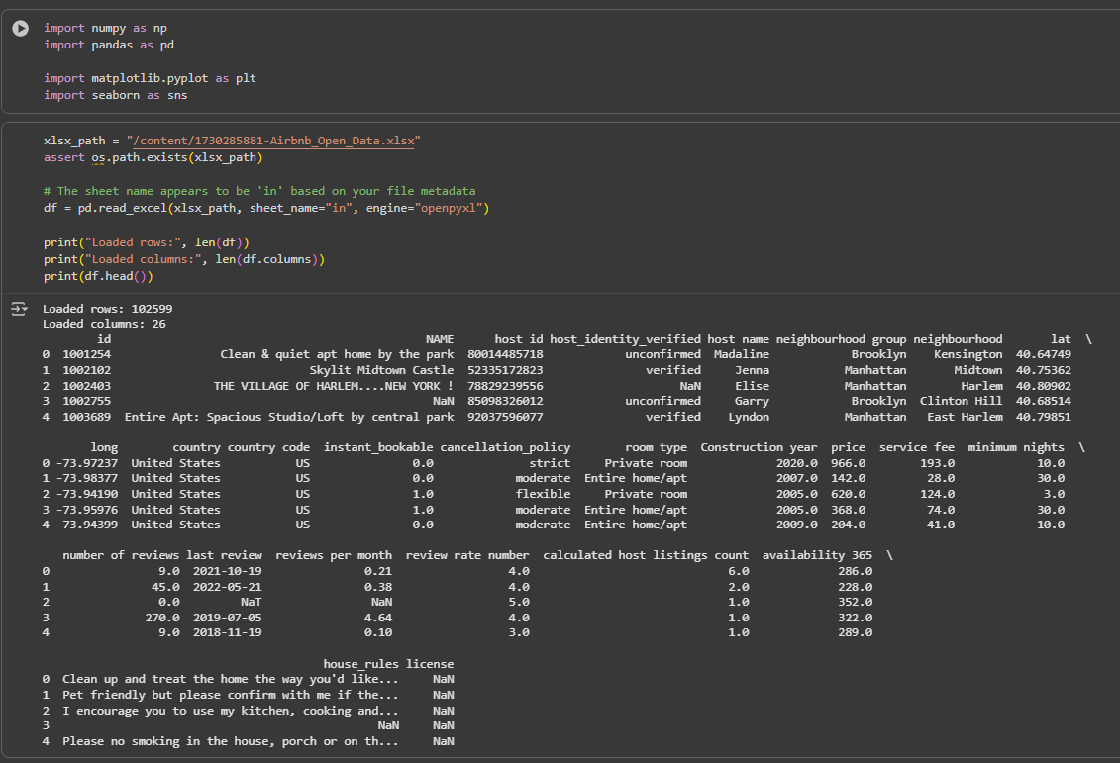
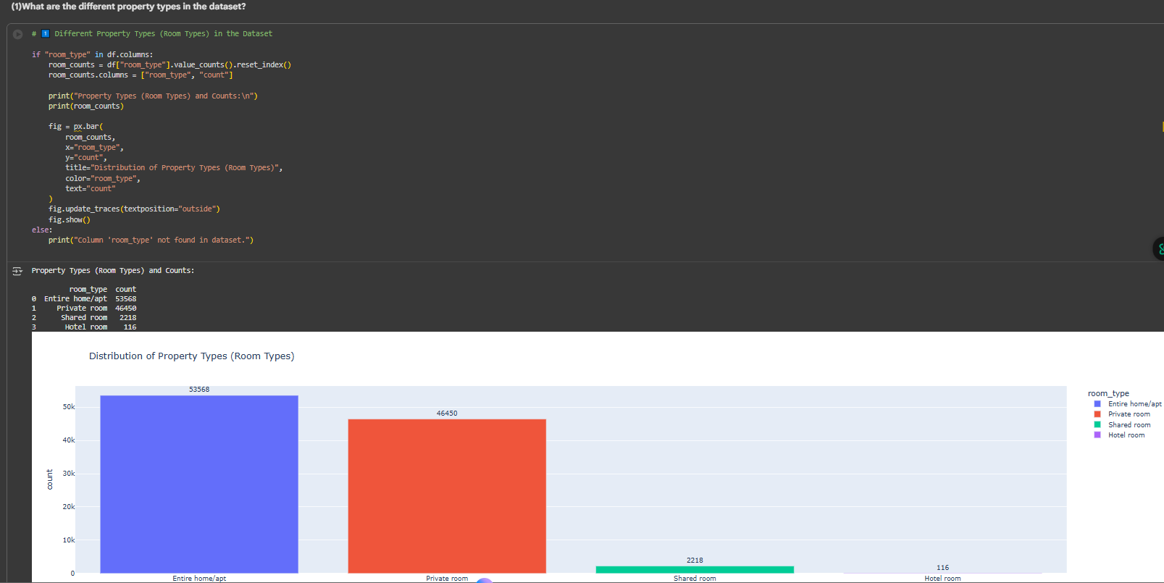
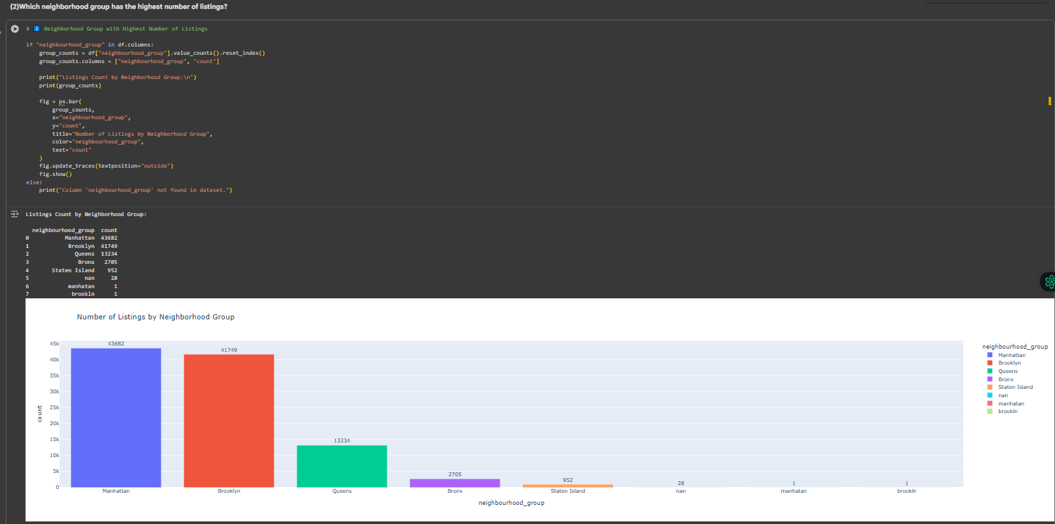
RESULTS1
Demo Link

Slide 7
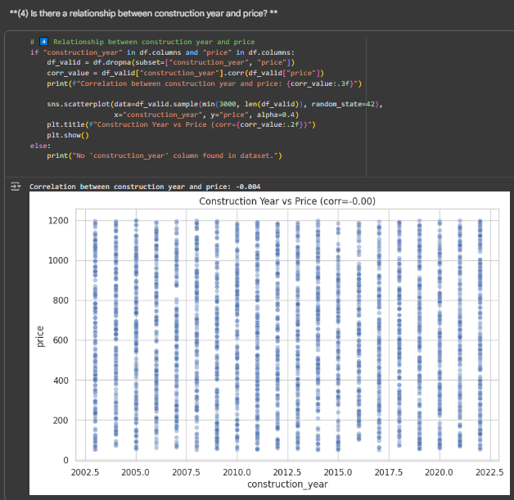
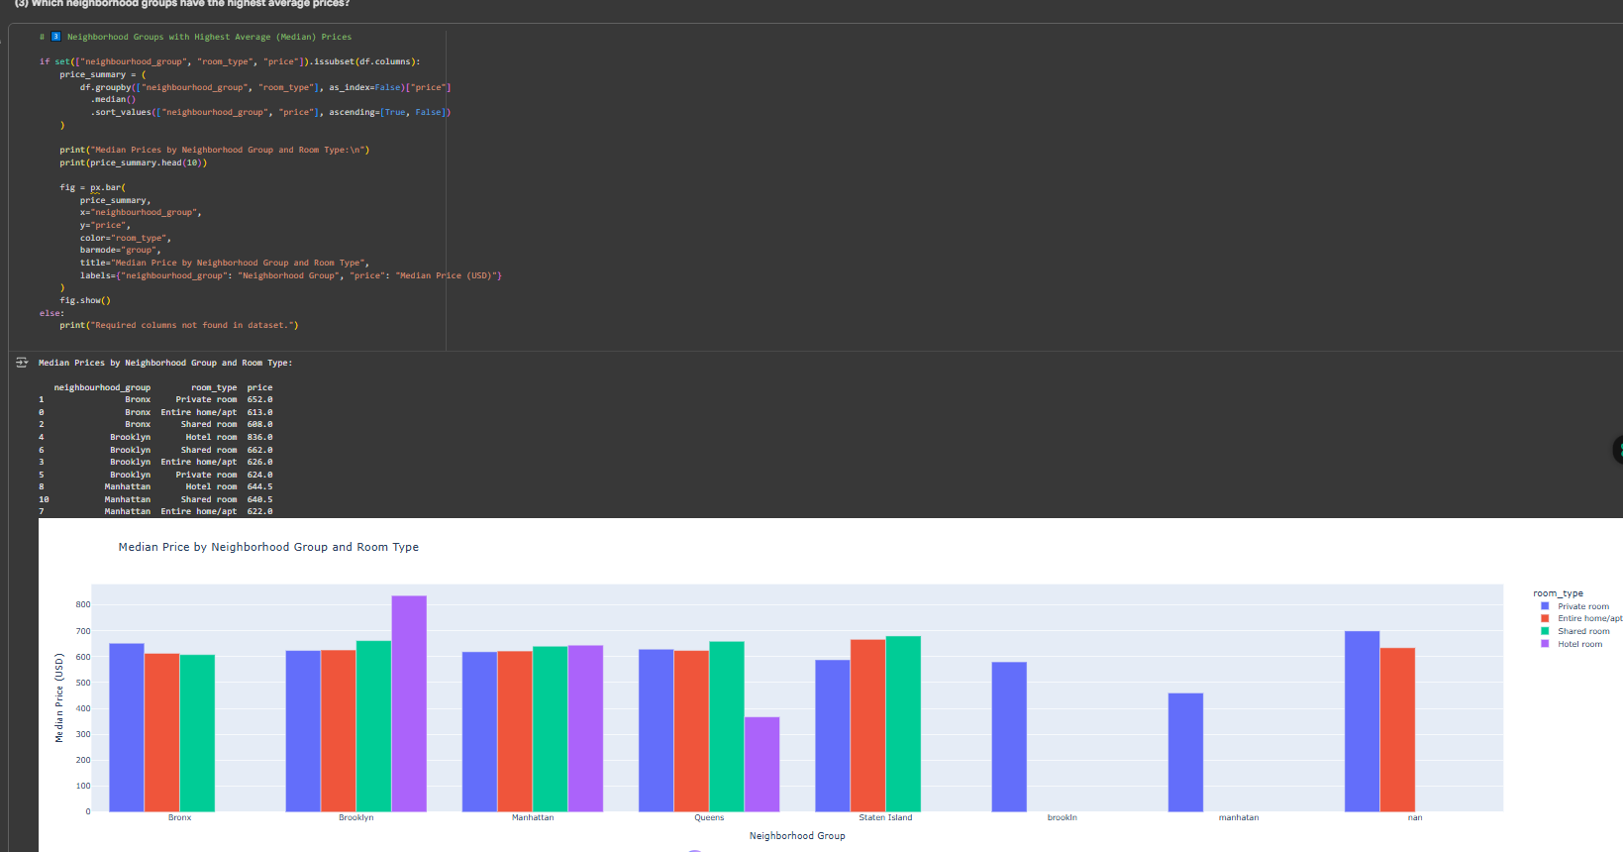
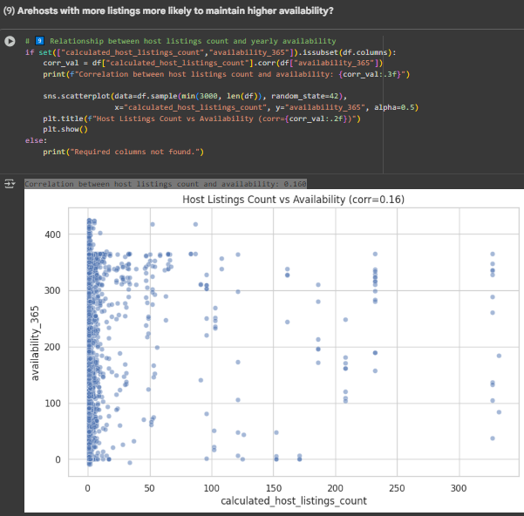
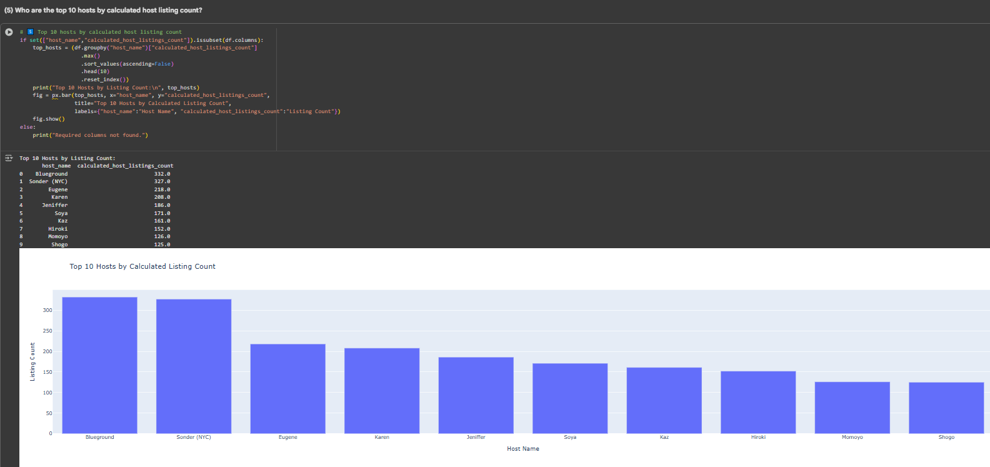
RESULTS2
[Add screen shots of your code or Chart(s) ]
Demo Link

Slide 8
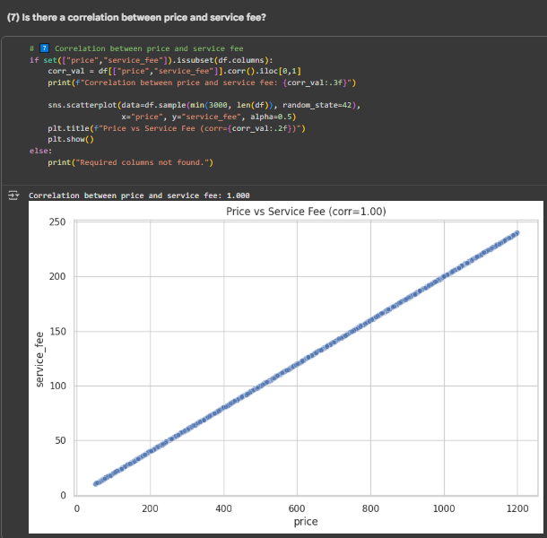
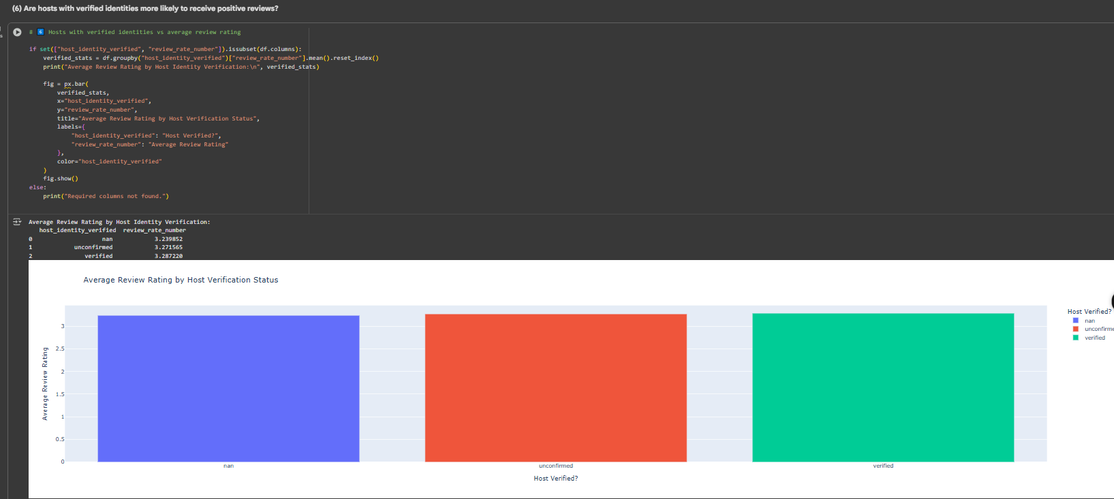
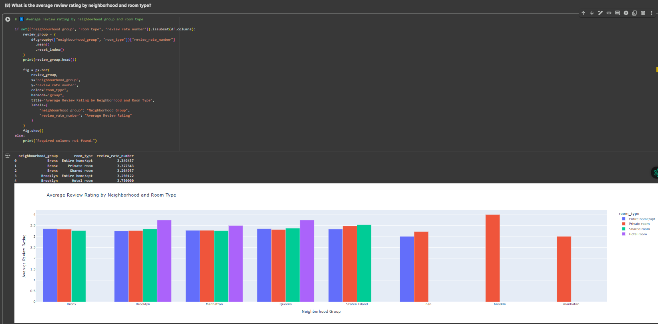
RESULTS3
[Add screen shots of your code or Chart(s) ]
Demo Link

Slide 9
GitHub repository
https://github.com/kottangicharan/VOIS_AICTE_Oct2025_Kottangi_Charan.git
Demo Link : https://colab.research.google.com/drive/1OovODRZq7p8hGqJxgp8_TUbDof4Q9CMx?usp=sharing

Slide 10
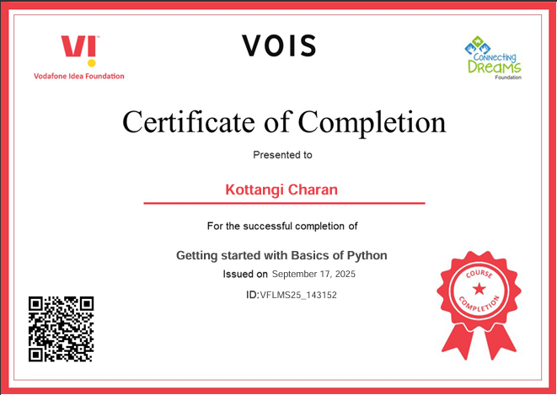
Getting started with Basics of Python Certificate
[Paste your Certificate Here]

Slide 11
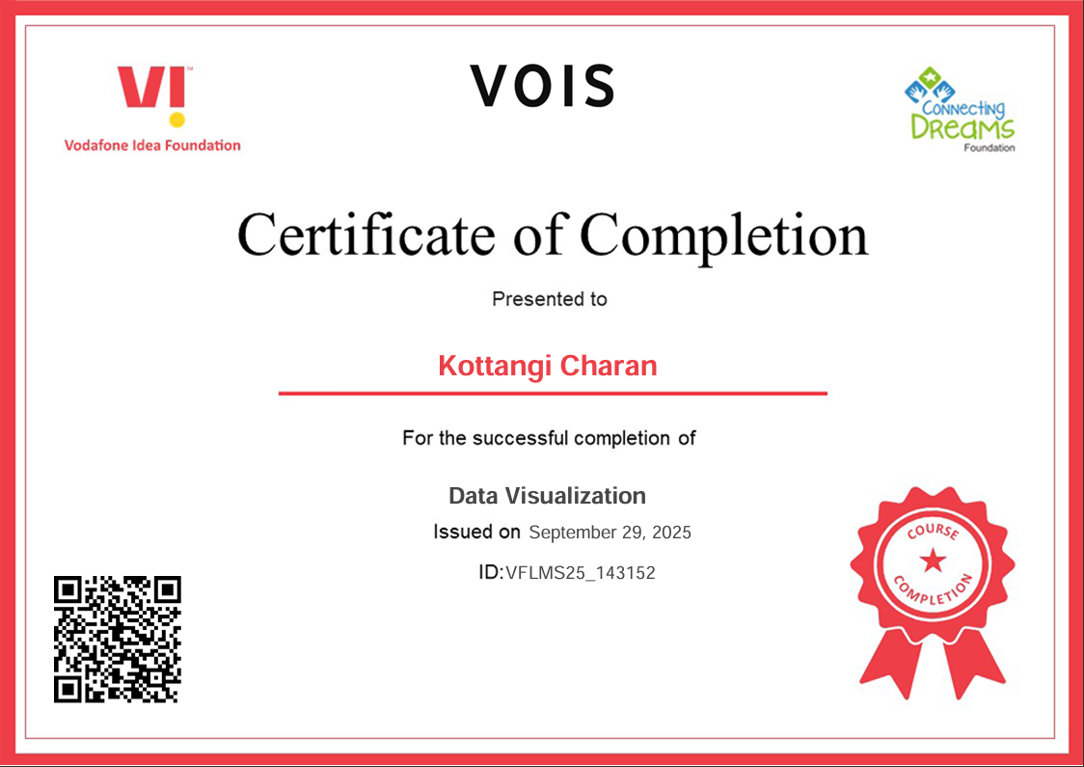
Data Visualization Certificate
[Paste your Certificate Here]

Slide 12
Thank you
Presented by: Charan
Project: Airbnb Hotel Booking Analysis
Platform: AICTE Internship | VOIS Program 2025
Thank you for your time and attention!
.
.

